Slide 1
Unit-3
Divide and Conquer Algorithm

Slide 2
Recurrence Equation

Slide 3
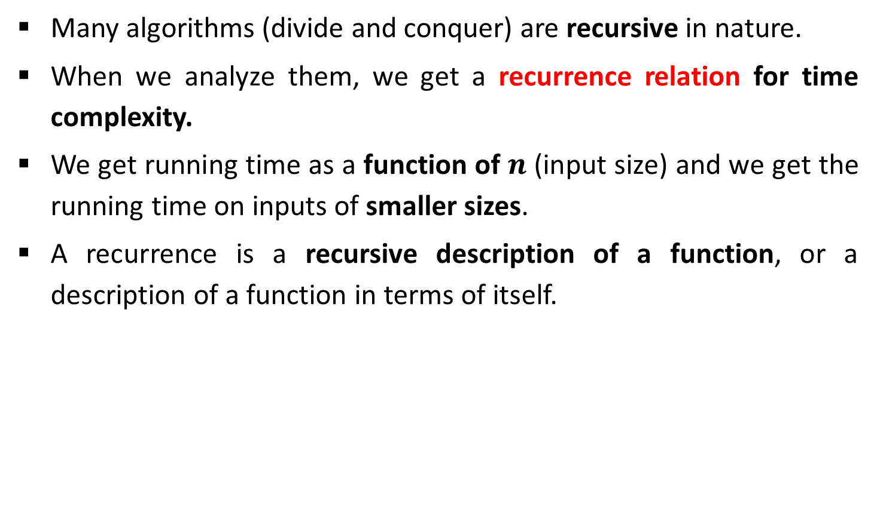
Introduction
Many algorithms (divide and conquer) are recursive in nature.
When we analyze them, we get a recurrence relation for time complexity.
We get running time as a function of $n$ (input size) and we get the running time on inputs of smaller sizes.
A recurrence is a recursive description of a function, or a description of a function in terms of itself.

Slide 4
Methods to Solve Recurrence
Substitution
Homogeneous (characteristic equation)
Inhomogeneous
Master method
Recurrence tree
Intelligent guess work
Change of variable
Range transformations

Slide 5

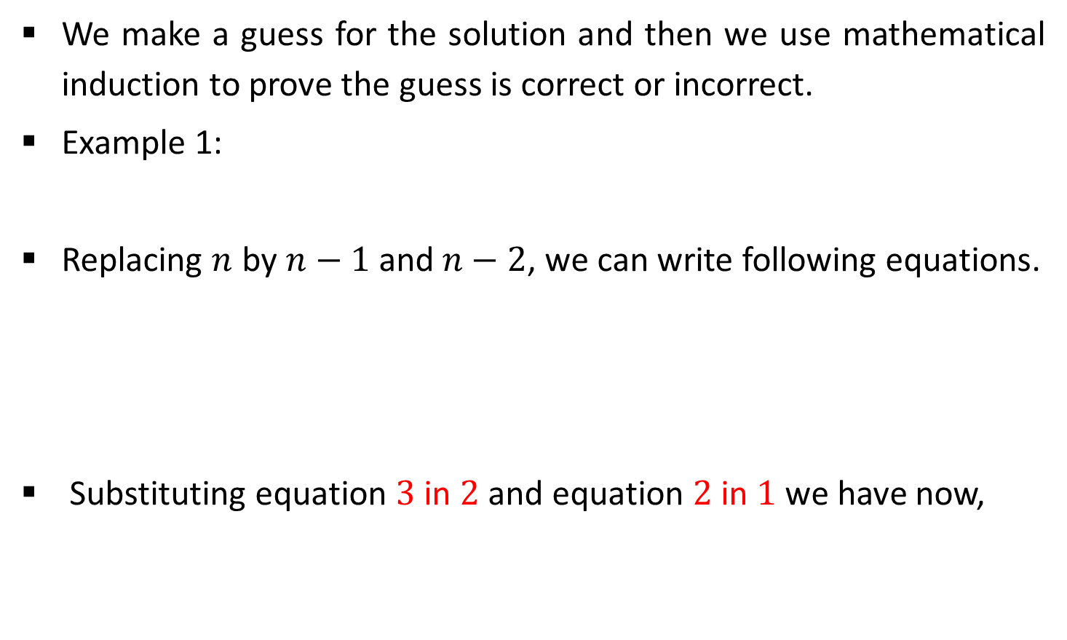



Substitution Method
We make a guess for the solution and then we use mathematical induction to prove the guess is correct or incorrect.
Example 1:
Replacing $n$ by $n−1$ and $n−2$, we can write following equations.
Substituting equation $3$ in $2$ and equation $2$ in $1$ we have now,
$$T(n)=T(n−1)+n$$
1
$$T(n−1)=T(n−2)+n−1$$
2
$$T(n−2)=T(n−3)+n−2$$
3
$$T(n)=T(n−3)+n−2+n−1+n$$
4

Slide 6

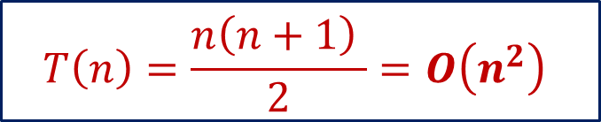


Substitution Method
From above, we can write the general form as,
Suppose, if we take $k = n$then,
$$T(n)=T(n−3)+n−2+n−1+n$$
4
$$T\left(n\right)=T\left(n−k\right)+(n−k+1)+(n−k+2)+ …+n$$
$$T(n)=T(n−n)+n−n+1+n−n+2+ …+n$$
$$T\left(n\right)=0+1+2+ …+n$$
$$T\left(n\right)=\frac{n\left(n+1\right) }{2}=O\left(n^{2}\right)$$

Slide 7
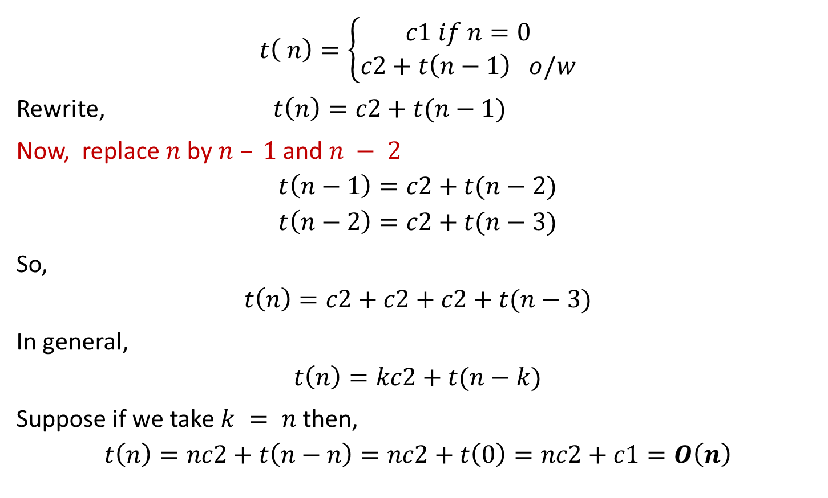
Exercise 1
$$t\left( n\right)=\left\{\begin{aligned}c1 if n=0 \\ c2+t\left(n−1\right) o/w\end{aligned}\right.$$
Rewrite, $t\left(n\right)=c2+t(n−1)$
Now, replace $n$ by $n – 1$and $n − 2$
$$t\left(n−1\right)=c2+t(n−2)$$
$$t\left(n−2\right)=c2+t(n−3)$$
So,
$$t\left(n\right)=c2+c2+c2+t(n−3)$$
In general,
$$t\left(n\right)=kc2+t(n−k)$$
Suppose if we take $k = n$then,
$$t\left(n\right)=nc2+t\left(n−n\right)=nc2+t\left(0\right)=nc2+c1=O\left(n\right)$$

Slide 8

Exercise 2
Solve the following recurrence using substitution method.
$$T\left( n\right)=\left\{\begin{aligned}1 if n=0 or 1 \\ T\left(n−1\right) +n−1 o/w\end{aligned}\right.$$

Slide 9
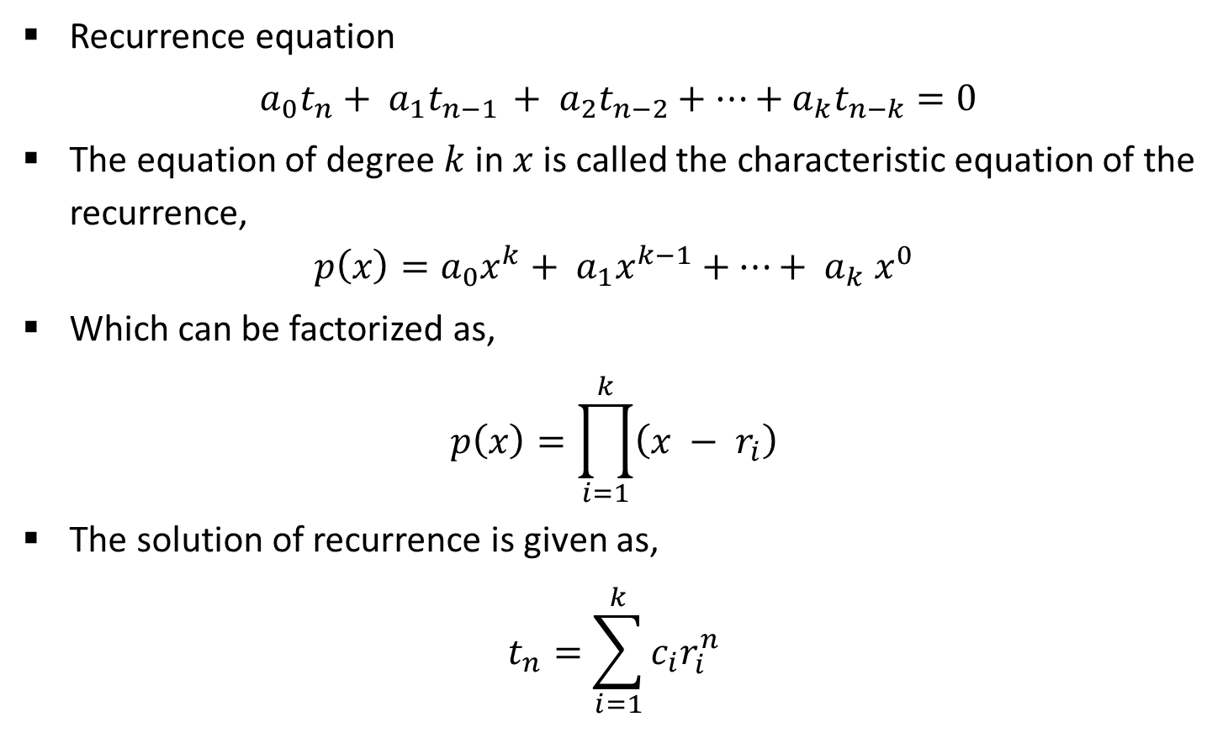
Homogeneous Recurrence
Recurrence equation
$a_{0}t_{n}+ a_{1}t_{n−1 }+ a_{2}t_{n−2}+⋯+a_{k}t_{n−k}=0$
The equation of degree $k$in $x$ is called the characteristic equation of the recurrence,
$$p\left(x\right)=a_{0}x^{k}+ a_{1}x^{k−1}+⋯+ a_{k} x^{0}$$
Which can be factorized as,
$$p\left(x\right)=\prod_{i=1}^{k}{\left(x − r_{i}\right)}$$
The solution of recurrence is given as,
$$t_{n}=\sum_{i=1}^{k}{c_{i}r_{i}^{n}}$$

Slide 10
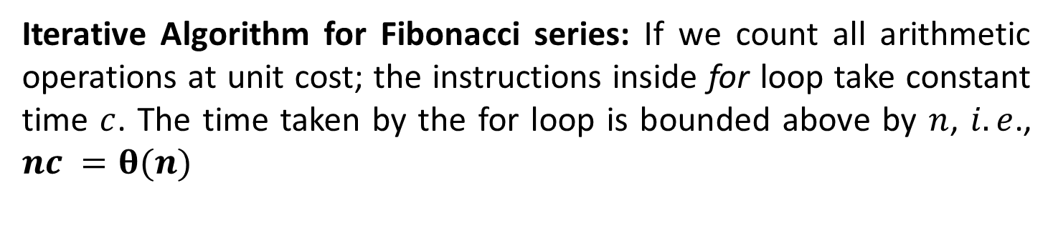
Analysis: Fibonacci series
Function fibiter(n)
i ← 1; j ← 0;
for k ← 1 to n do
j ← i + j;
i ← j – i;
return j
Iterative Algorithm for Fibonacci series: If we count all arithmetic operations at unit cost; the instructions inside for loop take constant time $c$. The time taken by the for loop is bounded above by $n$, $i.e$., $nc =θ(n)$

Slide 11
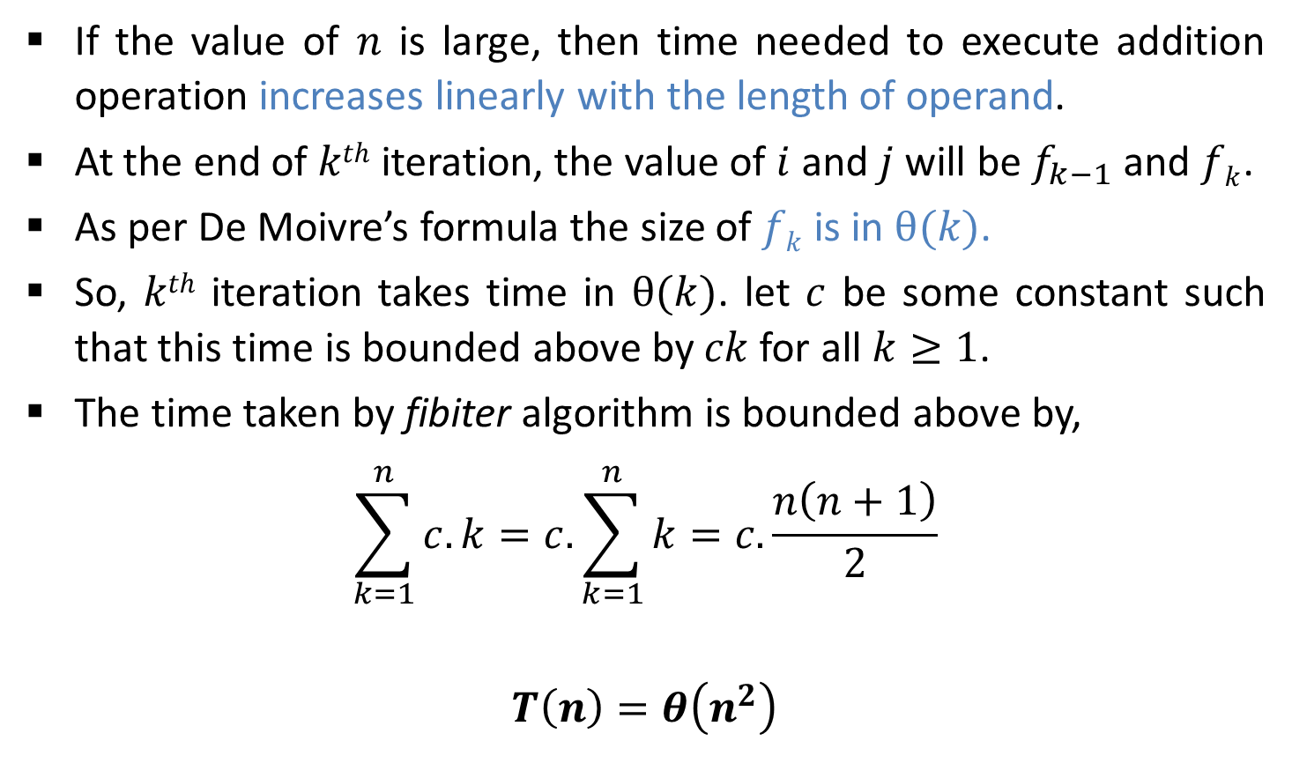
Analysis: Fibonacci series
If the value of $n$ is large, then time needed to execute addition operation increases linearly with the length of operand.
At the end of $kth$ iteration, the value of $i$ and $j$ will be $f_{k−1}$ and $fk$.
As per De Moivre’s formula the size of $fk$is in $θ(k)$.
So, $kth$ iteration takes time in $θ(k)$. let $c$ be some constant such that this time is bounded above by $ck$for all $k≥1$.
The time taken by fibiter algorithm is bounded above by,
$$\sum_{k=1}^{n}{c.k=c.\sum_{k=1}^{n}{k}}=c.\frac{n\left(n+1\right)}{2}$$
$$T\left(n\right)=θ\left(n^{2}\right)$$

Slide 12
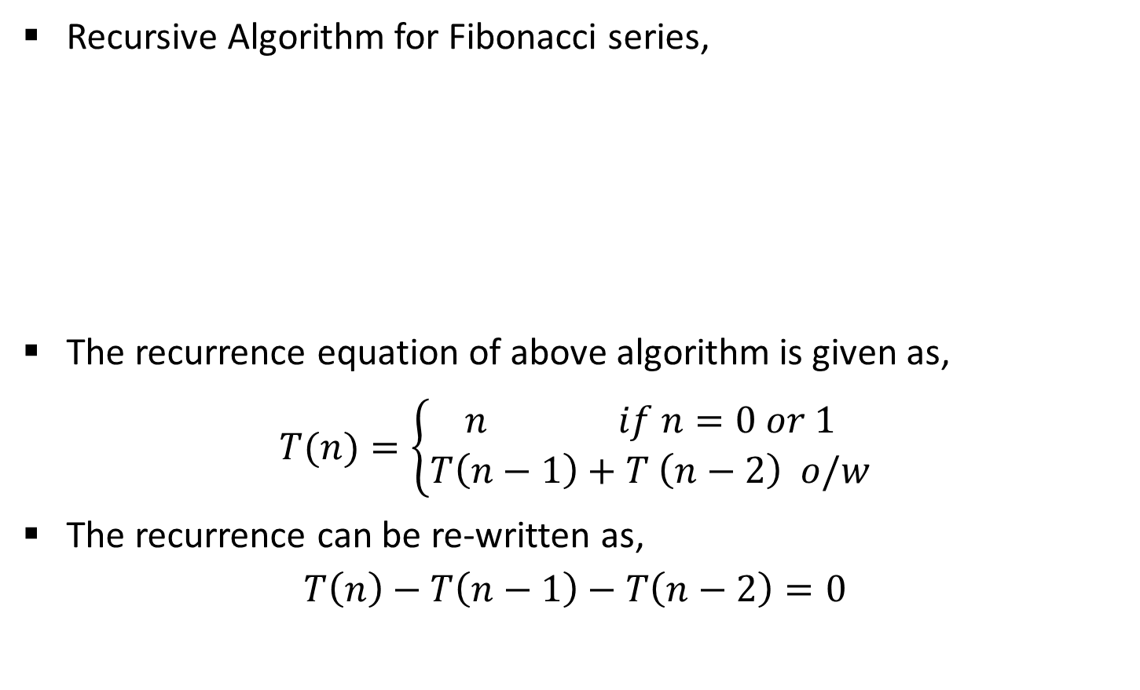
Analysis: Fibonacci series
Recursive Algorithm for Fibonacci series,
The recurrence equation of above algorithm is given as,
$$T(n)=\left\{\begin{aligned}n if n=0 or 1 \\ T\left(n−1\right)+T \left(n−2\right) o/w\end{aligned}\right.$$
The recurrence can be re-written as,
$$T\left(n\right)−T\left(n−1\right)−T\left(n−2\right)=0$$
Function fibrec(n)
if n < 2 then return n
else return fibrec (n – 1) + fibrec (n – 2)

Slide 13

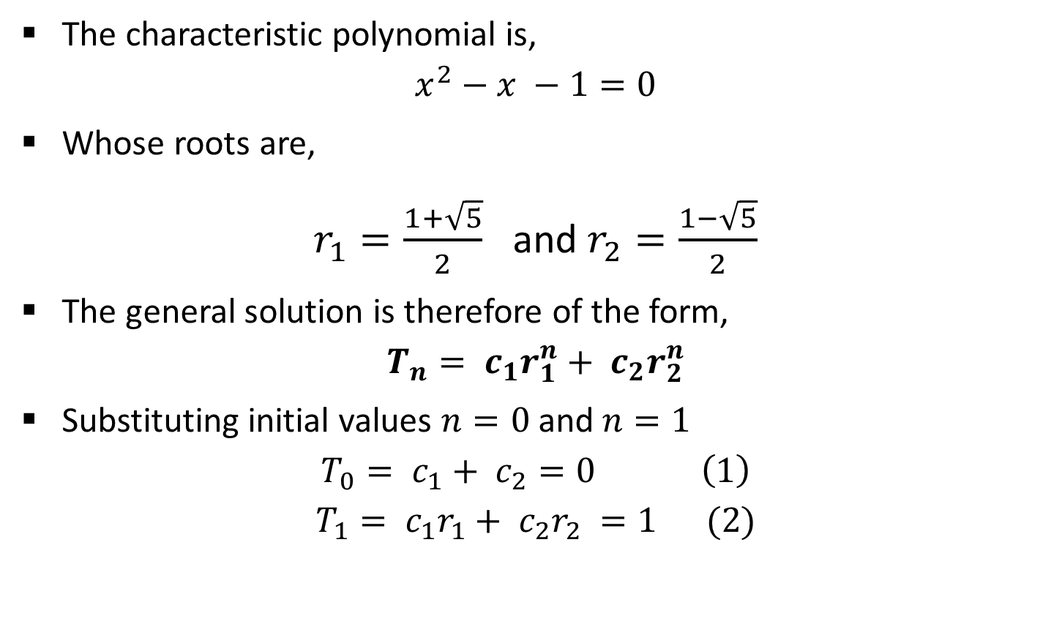

Analysis: Fibonacci series
The characteristic polynomial is,
$$x^{2}−x −1=0$$
Whose roots are,
$r_{1}=\frac{1+\sqrt{5}}{2}$ and $r_{2}=\frac{1−\sqrt{5}}{2}$
The general solution is therefore of the form,
$$T_{n}= c_{1}r_{1}^{n}+ c_{2}r_{2}^{n}$$
Substituting initial values $n=0$and $n=1$
$$T_{0}= c_{1}+ c_{2}=0 \left(1\right)$$
$$T_{1}= c_{1}r_{1}+ c_{2}r_{2} =1 (2)$$
$$x =\frac{−b±\sqrt{b^{2}−4ac}}{2a}$$
$$t_{n}=\sum_{i=1}^{k}{c_{i}r_{i}^{n}}$$

Slide 14
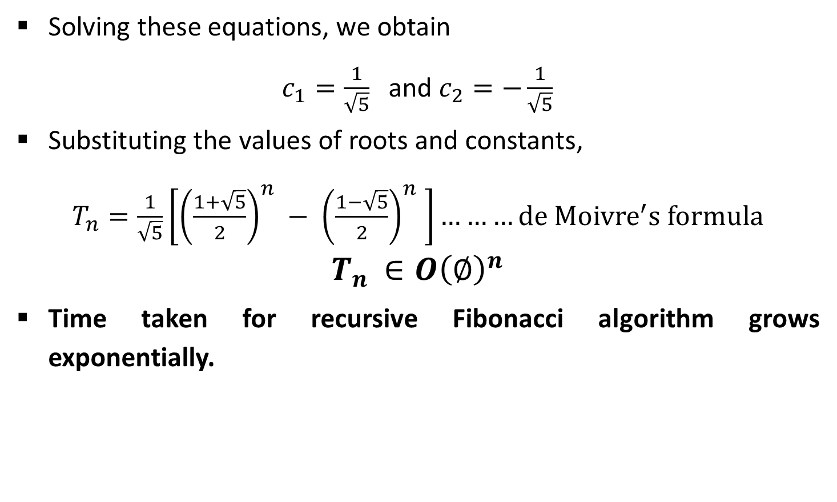
Analysis: Fibonacci series
Solving these equations, we obtain
$c_{1}=\frac{1}{\sqrt{5}}$ and $c_{2}=−\frac{1}{\sqrt{5}}$
Substituting the values of roots and constants,
$T_{n}=\frac{1}{\sqrt{5}}\left[{\left(\frac{1+\sqrt{5}}{2}\right)}^{n} − {\left(\frac{1−\sqrt{5}}{2}\right)}^{n} \right]………de {Moivre}^{′}s formula$
$$T_{n }∈O{\left(∅\right)}^{n}$$
Time taken for recursive Fibonacci algorithm grows exponentially.

Slide 15
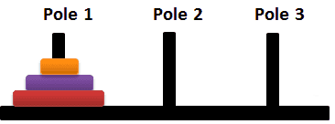



Analysis: Tower of Hanoi

Slide 16



Analysis: Tower of Hanoi

Slide 17
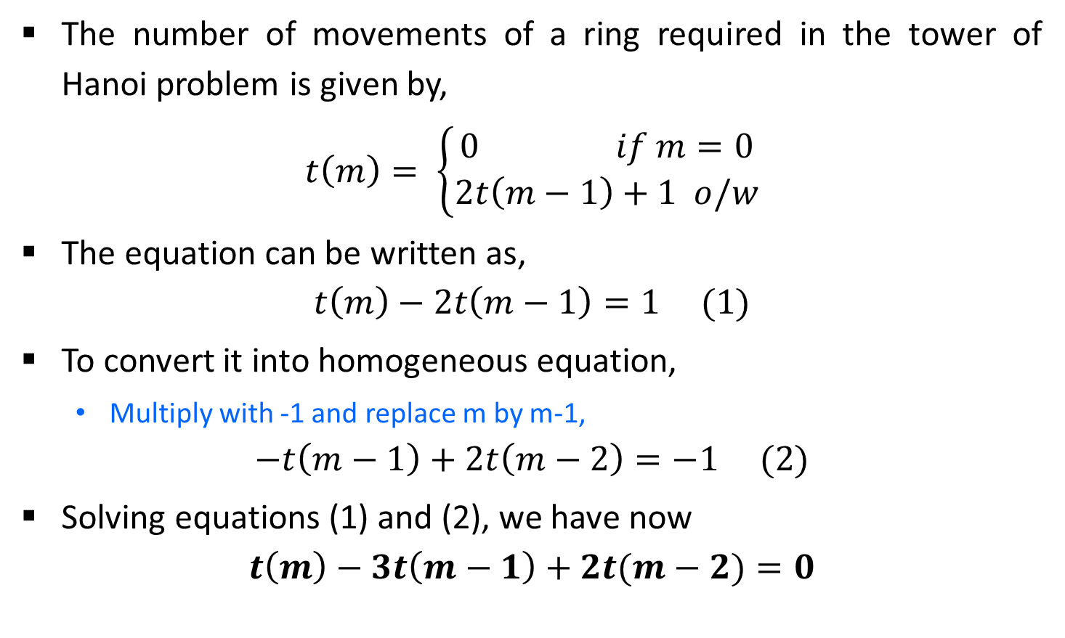
Analysis: Tower of Hanoi
The number of movements of a ring required in the tower of Hanoi problem is given by,
$$t\left(m\right)= \left\{\begin{aligned}0 if m=0 \\ 2t\left(m−1\right)+1 o/w\end{aligned}\right.$$
The equation can be written as,
$$t\left(m\right)−2t\left(m−1\right)=1 (1)$$
To convert it into homogeneous equation,
Multiply with -1 and replace m by m-1,
$$−t\left(m−1\right)+2t\left(m−2\right)=−1 (2)$$
Solving equations (1) and (2), we have now
$$t\left(m\right)−3t\left(m−1\right)+2t(m−2)=0$$
Inhomogeneous equation

Slide 18
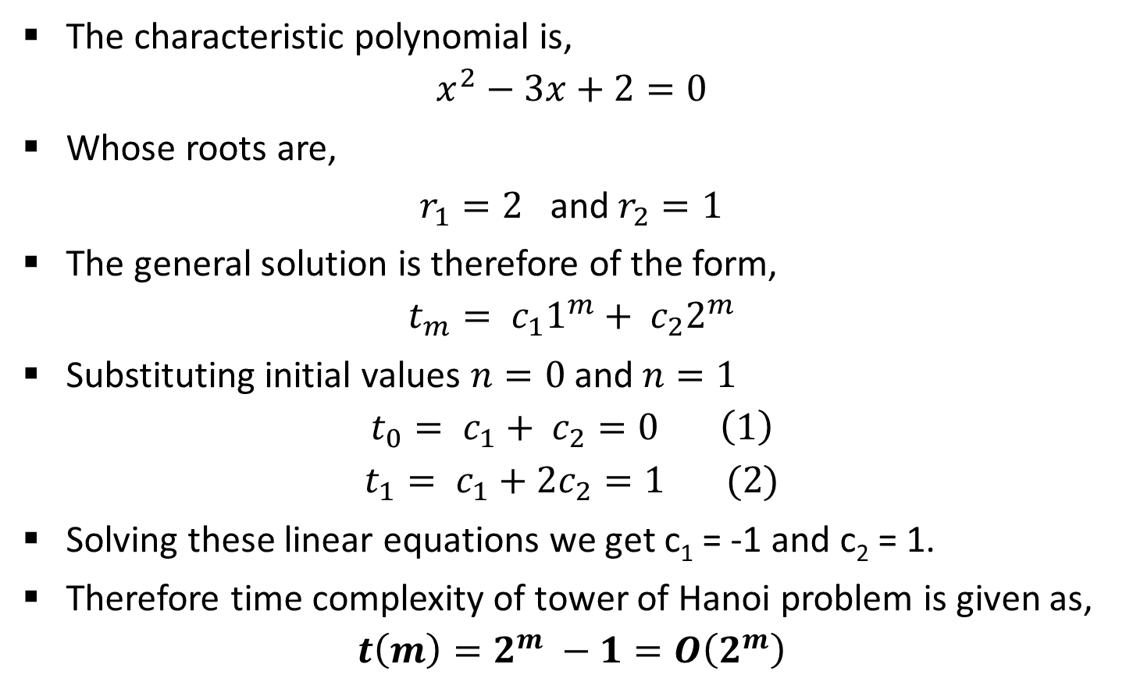
Analysis: Tower of Hanoi
The characteristic polynomial is,
$$x^{2}−3x+2=0$$
Whose roots are,
$r_{1}=2$ and $r_{2}=1$
The general solution is therefore of the form,
$$t_{m}= c_{1}1^{m}+ c_{2}2^{m}$$
Substituting initial values $n=0$and $n=1$
$$t_{0}= c_{1}+ c_{2}=0 \left(1\right)$$
$$t_{1}= c_{1}+2c_{2}=1 (2)$$
Solving these linear equations we get c₁ = -1 and c₂ = 1.
Therefore time complexity of tower of Hanoi problem is given as,
$$t\left(m\right)=2^{m} −1=O\left(2^{m}\right)$$

Slide 19

Exercise
Solve the following recurrences
$t_{n}=\left\{\begin{aligned}n if n=0 or 1 \\ 5t_{n−1 }−6t_{n−2 O/W}\end{aligned}\right.$
$t_{n}=\left\{\begin{aligned}n if n=0, 1 or 2 \\ 5t_{n−1 }−8t_{n−2 }+4t_{n−3} o/w\end{aligned}\right.$

Slide 20
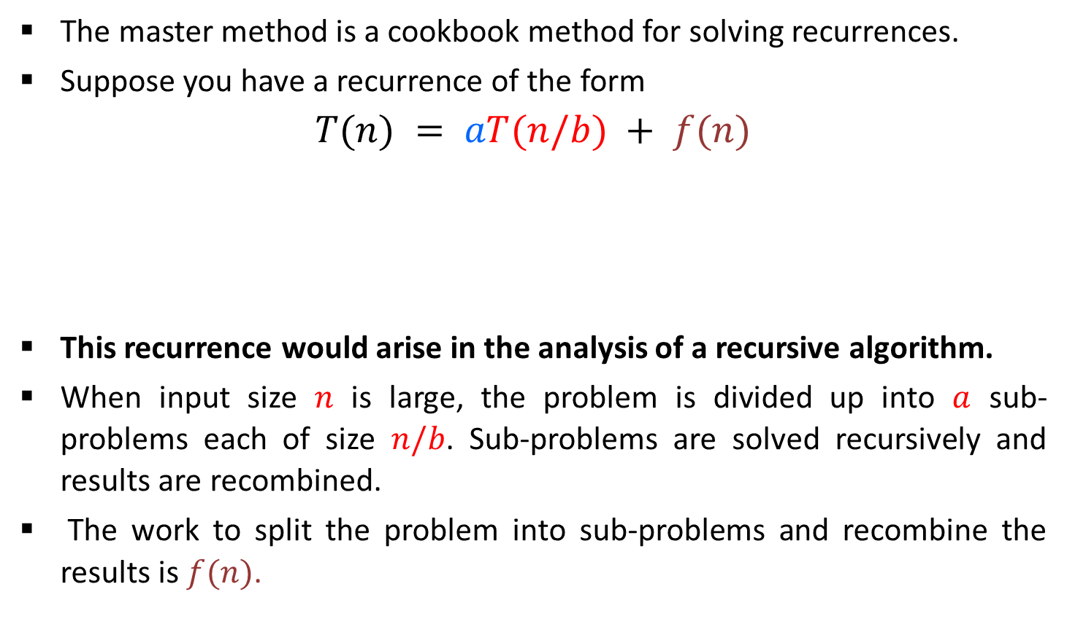
Master Method
The master method is a cookbook method for solving recurrences.
Suppose you have a recurrence of the form
$$T(n) = aT(n/b) + f(n)$$
This recurrence would arise in the analysis of a recursive algorithm.
When input size $n$ is large, the problem is divided up into $a$ sub-problems each of size $n/b$. Sub-problems are solved recursively and results are recombined.
The work to split the problem into sub-problems and recombine the results is $f(n)$.
Time to divide & recombine
Number of sub-problems
Time required to solve a sub-problem

Slide 21
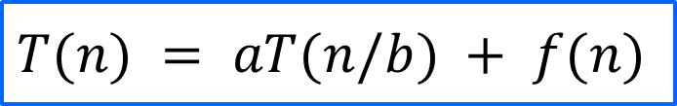
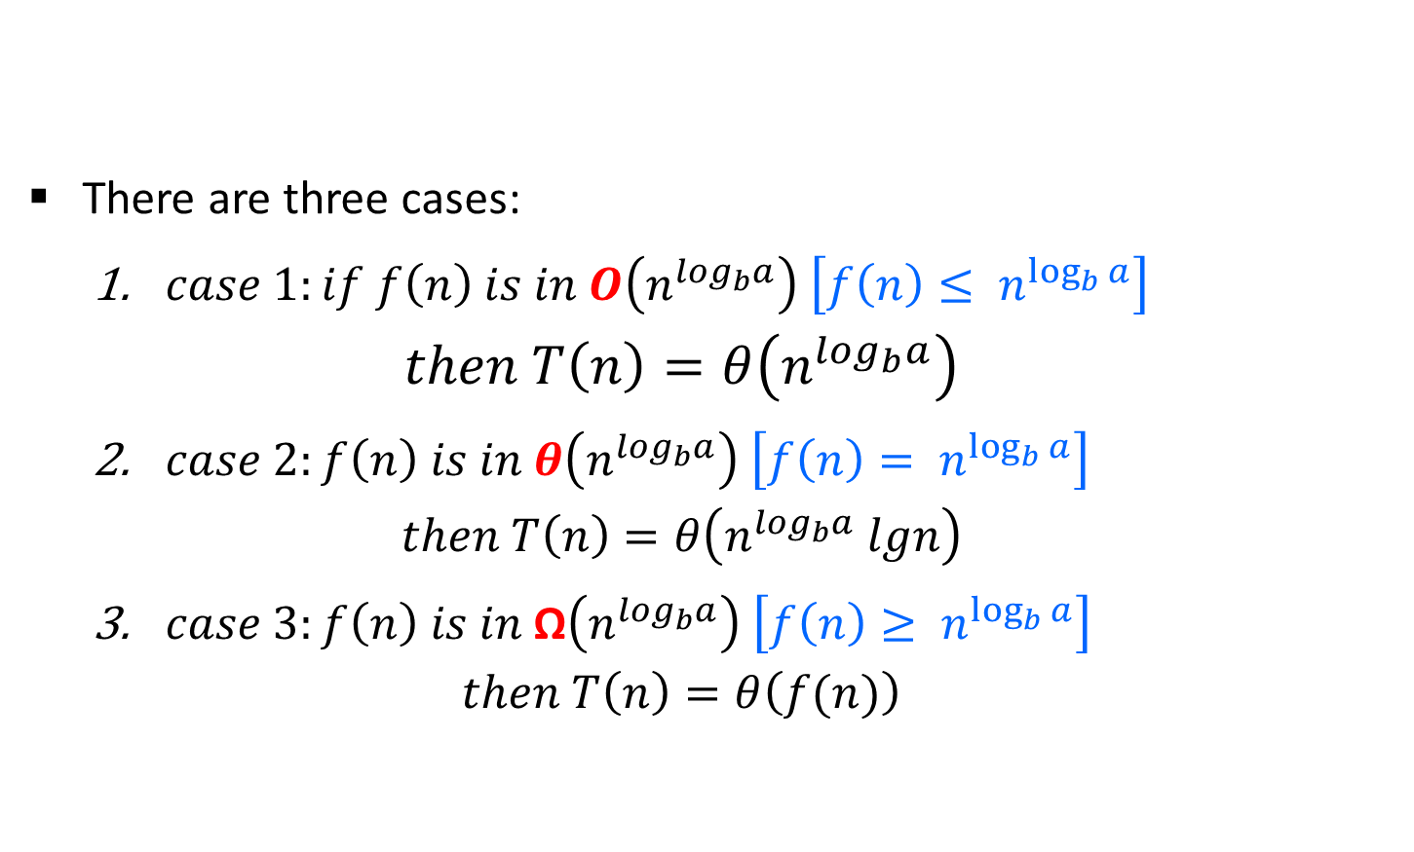
Master Method
There are three cases:
$case 1:if f\left(n\right) is in O\left(n^{\log_{b}a}\right) \left[f\left(n\right)≤ n^{\log_{b}{a}}\right]$
$$then T\left(n\right)=θ\left(n^{\log_{b}a}\right)$$
$case 2:f\left(n\right) is in θ\left(n^{\log_{b}a}\right) \left[f\left(n\right)= n^{\log_{b}{a}}\right]$
$$then T\left(n\right)=θ\left(n^{\log_{b}a} lgn\right)$$
$case 3:f\left(n\right) is in \text{Ω}\left(n^{\log_{b}a}\right) \left[f\left(n\right)≥ n^{\log_{b}{a}}\right]$
$$then T\left(n\right)=θ\left(f(n)\right)$$
$$T(n) = aT(n/b) + f(n)$$

Slide 22

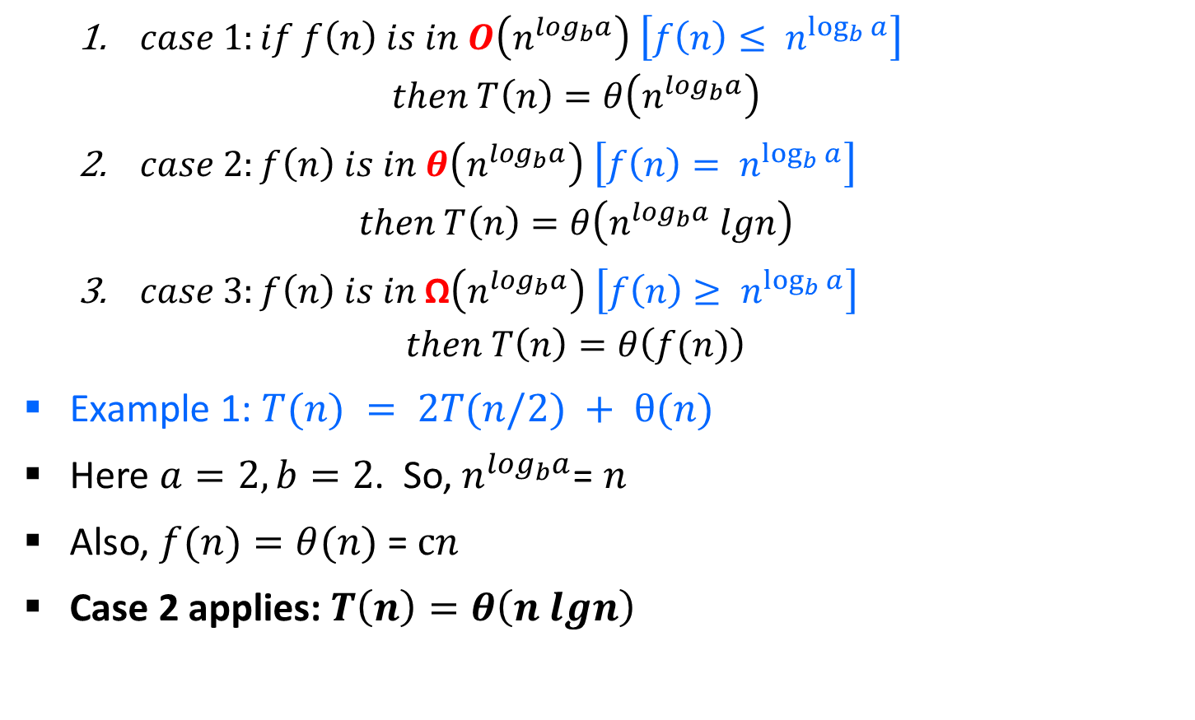
Master Method
$case 1:if f\left(n\right) is in O\left(n^{\log_{b}a}\right) \left[f\left(n\right)≤ n^{\log_{b}{a}}\right]$
$$then T\left(n\right)=θ\left(n^{\log_{b}a}\right)$$
$case 2:f\left(n\right) is in θ\left(n^{\log_{b}a}\right) \left[f\left(n\right)= n^{\log_{b}{a}}\right]$
$$then T\left(n\right)=θ\left(n^{\log_{b}a} lgn\right)$$
$case 3:f\left(n\right) is in \text{Ω}\left(n^{\log_{b}a}\right) \left[f\left(n\right)≥ n^{\log_{b}{a}}\right]$
$$then T\left(n\right)=θ\left(f(n)\right)$$
Example 1: $T(n) = 2T(n/2) + θ(n)$
Here $a=2, b=2$. So,${ n}^{\log_{b}a}$= $n$
Also, $f(n)=θ(n)$= $cn$
Case 2 applies: $T\left(n\right)=θ\left(n lgn\right)$
Merge sort
$$T(n) = aT(n/b) + f(n)$$

Slide 23
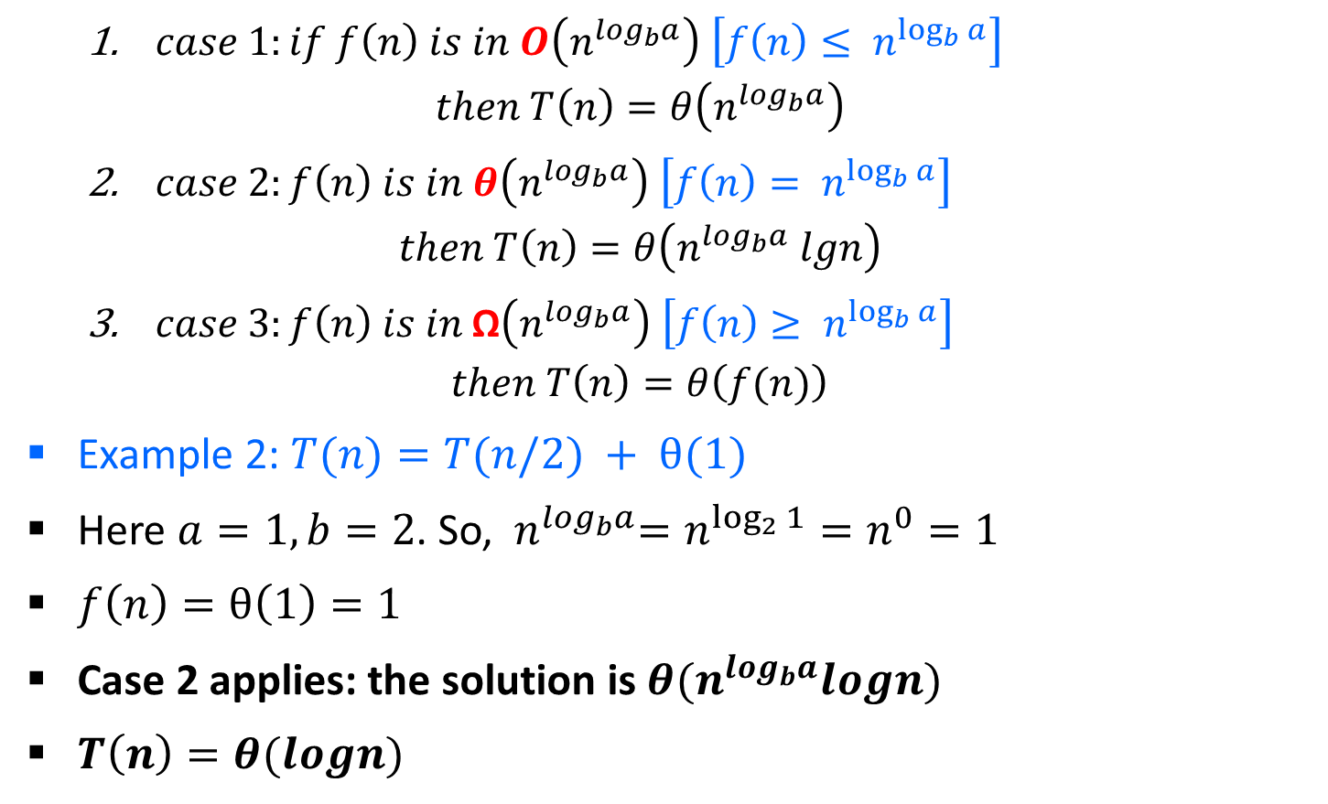
Master Method
$case 1:if f\left(n\right) is in O\left(n^{\log_{b}a}\right) \left[f\left(n\right)≤ n^{\log_{b}{a}}\right]$
$$then T\left(n\right)=θ\left(n^{\log_{b}a}\right)$$
$case 2:f\left(n\right) is in θ\left(n^{\log_{b}a}\right) \left[f\left(n\right)= n^{\log_{b}{a}}\right]$
$$then T\left(n\right)=θ\left(n^{\log_{b}a} lgn\right)$$
$case 3:f\left(n\right) is in \text{Ω}\left(n^{\log_{b}a}\right) \left[f\left(n\right)≥ n^{\log_{b}{a}}\right]$
$$then T\left(n\right)=θ\left(f(n)\right)$$
Example 2: $T(n)=T(n/2) + θ(1)$
Here $a=1, b=2$. So, ${ n}^{\log_{b}a}=n^{\log_{2}{1}}=n^{0}=1$
$f\left(n\right)=θ\left(1\right)=1$
Case 2 applies: the solution is $θ(n^{\log_{b}a}logn)$
$T\left(n\right)=θ(logn)$
Binary Search
$$T(n) = aT(n/b) + f(n)$$

Slide 24
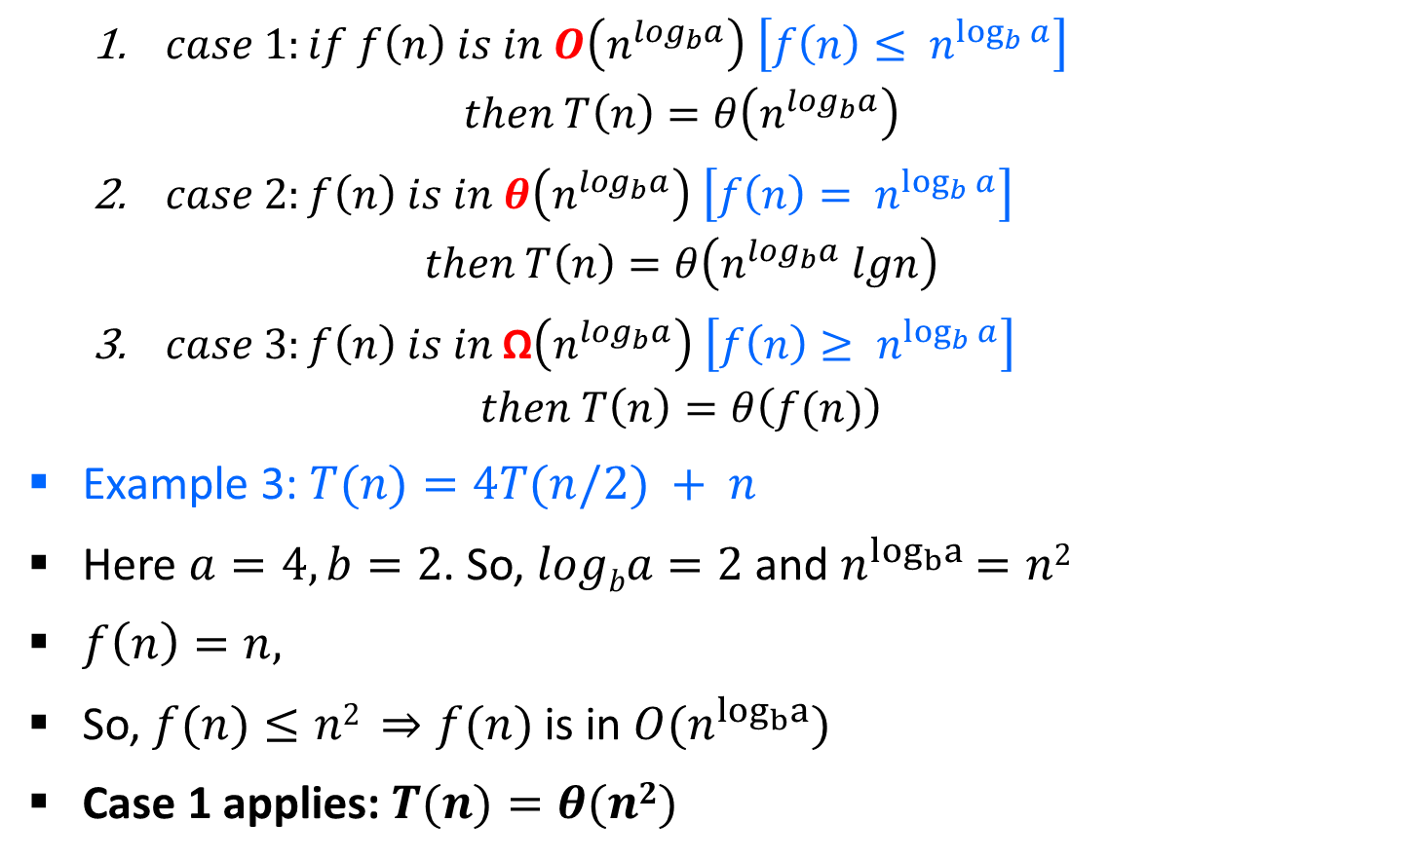
Master Method
$case 1:if f\left(n\right) is in O\left(n^{\log_{b}a}\right) \left[f\left(n\right)≤ n^{\log_{b}{a}}\right]$
$$then T\left(n\right)=θ\left(n^{\log_{b}a}\right)$$
$case 2:f\left(n\right) is in θ\left(n^{\log_{b}a}\right) \left[f\left(n\right)= n^{\log_{b}{a}}\right]$
$$then T\left(n\right)=θ\left(n^{\log_{b}a} lgn\right)$$
$case 3:f\left(n\right) is in \text{Ω}\left(n^{\log_{b}a}\right) \left[f\left(n\right)≥ n^{\log_{b}{a}}\right]$
$$then T\left(n\right)=θ\left(f(n)\right)$$
Example 3: $T(n)=4T(n/2) + n$
Here $a=4, b=2$. So, $logba=2$and $n^{\log_{b}a}$ $=n2$
$f\left(n\right)=n,$
So, $f(n)≤n2 ⇒f(n)$is in $O(n^{\log_{b}a})$
Case 1 applies: $T(n)=θ(n2)$
$$T(n) = aT(n/b) + f(n)$$

Slide 25
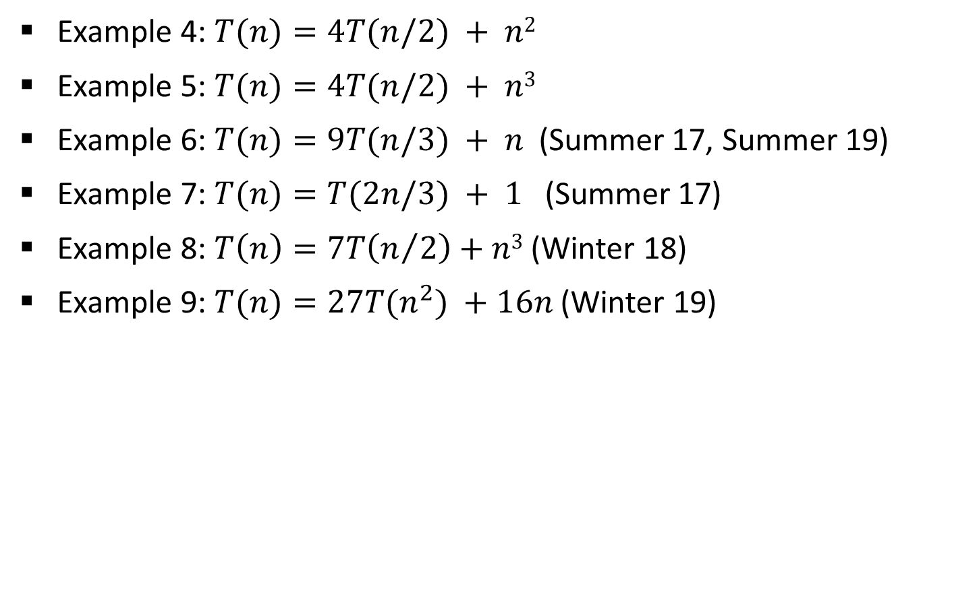
Master Method
Example 4: $T(n)=4T(n/2) + n2$
Example 5: $T(n)=4T(n/2) + n3$
Example 6: $T(n)=9T(n/3) + n$(Summer 17, Summer 19)
Example 7: $T(n)=T(2n/3) + 1$(Summer 17)
Example 8: $T\left(n\right)=7T\left(n/2\right)+n3$ (Winter 18)
Example 9: $T(n)=27T(n^{2}) +16n$ (Winter 19)

Slide 26
Recurrence Tree Method
In recurrence tree, each node represents the cost of a single sub-problem in the set of recursive function invocations.
We sum the costs within each level of the tree to obtain a set of per level costs.
Then we sum the all the per level costs to determine the total cost of all levels of the recursion.

Slide 27


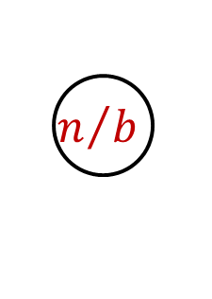
Recurrence Tree Method
Here while solving recurrences, we divide the problem into sub-problems of equal size.
E.g., $T(n)=a T(n/b) + f(n)$where $a>1 ,b>1$and $f(n)$ is a given function.
$F(n)$ is the cost of splitting or combining the sub problems.
$$n$$
$$n/b$$
$$n/b$$

Slide 28
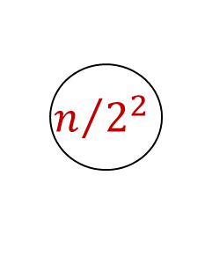


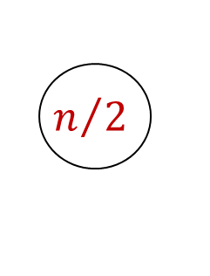



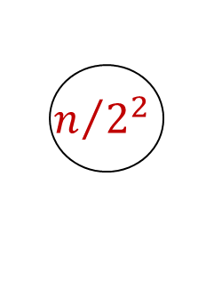




Recurrence Tree Method
Example 1: $T(n)=2T(n/2)+n$
The recursion tree for this recurrence is :
$$n$$
$$n/2$$
$$n/2$$
$$n$$
$$log2 n$$
$$n/{2^{2}}$$
$$n/{2^{2}}$$
$$n/{2^{2}}$$
$$n/{2^{2}}$$
$$n$$
$$1$$
$$1$$
$$1$$
$$1$$
$$1$$

Slide 29
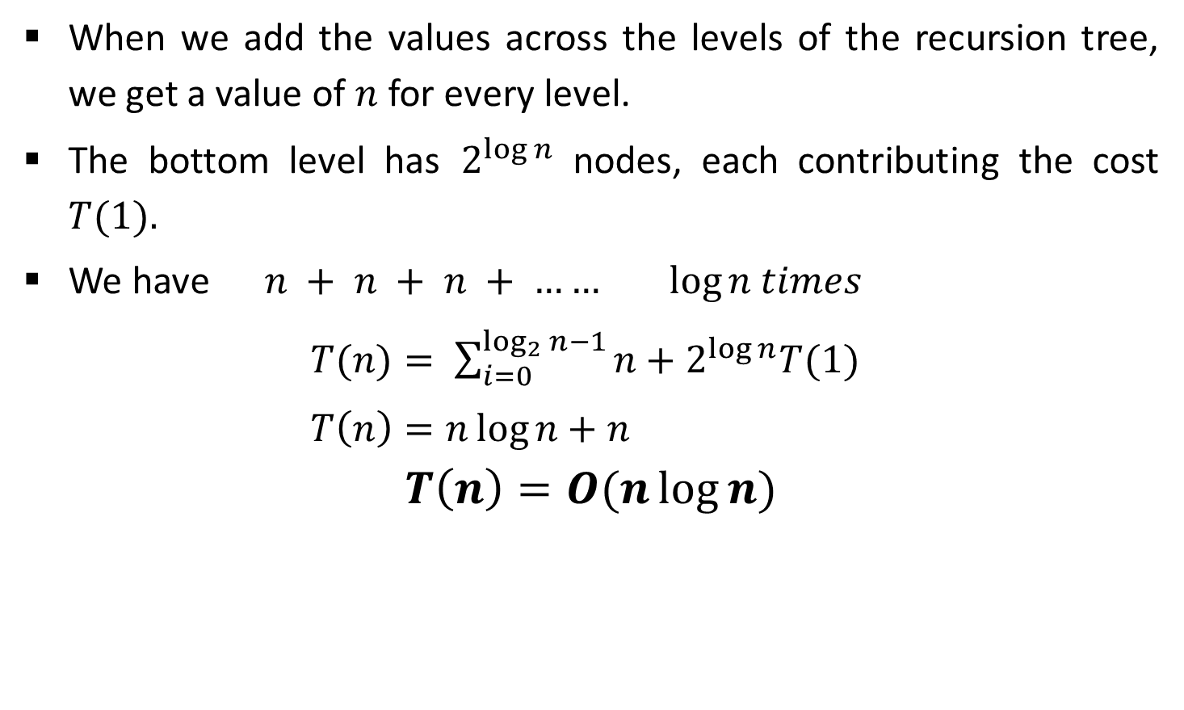
Recurrence Tree Method
When we add the values across the levels of the recursion tree, we get a value of $n$ for every level.
The bottom level has $2^{\log{n}}$ nodes, each contributing the cost $T(1).$
We have $n + n + n + …… log⁡n$ $times$
$T(n)= \sum_{i=0}^{\log_{2}{n}−1}{n+2^{\log{n}}T(1)}$
$T\left(n\right)=n\log{n}+n$
$$T\left(n\right)=O(n\log{n)}$$

Slide 30












Recurrence Tree Method
Example 2: $T(n)=T(n/3)+T(2n/3) + n$
The recursion tree for this recurrence is :
$$n$$
$$n/3$$
$${2n}/3$$
$$n$$
$$log3 n$$
$$log3/2 n$$
$$\frac{1}{3}\frac{n}{3}$$
$$\frac{2}{3}\frac{n}{3}$$
$$\frac{1}{3}\frac{2n}{3}$$
$$\frac{2}{3}\frac{2n}{3}$$
$$n$$

Slide 31

Recurrence Tree Method
$$T(n)= \sum_{i=0}^{\log_{3/2}{n}−1}{n+n^{\log_{3/2}{2}}T(1)}$$
$T(n)∈n \log_{3/2}{n}$

Slide 32
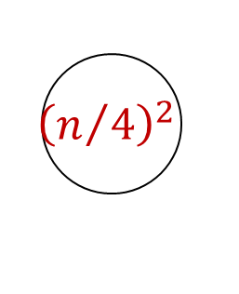
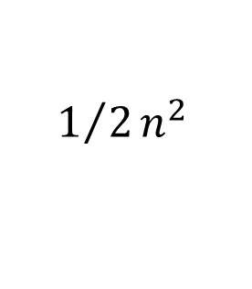





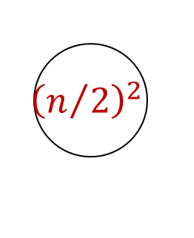
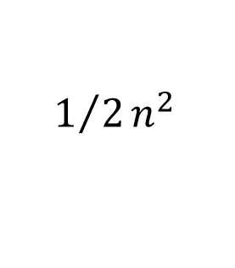
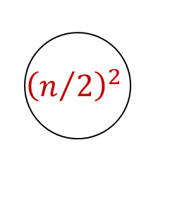
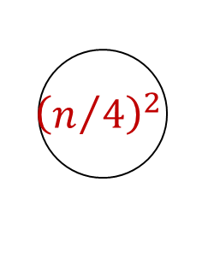
Recurrence Tree Method
Example 2: $T(n)=2T(n/2)+c.n2$
The recursion tree for this recurrence is :
$$n^{2}$$
$${\left(n/2\right)}^{2}$$
$${\left(n/2\right)}^{2}$$
$${1/2n}^{2}$$
$${\left(n/4\right)}^{2}$$
$${\left(n/4\right)}^{2}$$
$${\left(n/4\right)}^{2}$$
$${\left(n/4\right)}^{2}$$
$${1/2n}^{2}$$
$$O\left(n^{2}\right)$$
32

Slide 33

Recurrence Tree Method
Sub-problem size at level$i$is $n/{2^{i}}$
Cost of problem at level $i$Is ${\left(n/{2^{i}}\right)}^{2}$
Total cost,
$$T\left(n\right)=n^{2}\sum_{i=0}^{\log_{2}{n−1}}{{\left(\frac{1}{2}\right)}^{i}}+O\left(n\right)$$
$$T\left(n\right)= {2n}^{2}+O\left(n\right)$$
$$T\left(n\right)=O\left(n^{2}\right)$$

Slide 34

Recurrence Tree Method
Example 3: $T(n)= T(n/4)+T(3n/4)+c.n$
Example 4: $T(n)=3T(n/4)+c.n2$
Example 5: $T(n)=T(n/4)+T(n/2)+n2$
$\text{Example}\text{ 6:} T(n)=T(n/3)+T(2n/3) + n$

Slide 35
Divide & Conquer (D&C) Technique
Many useful algorithms are recursive in structure: to solve a given problem, they call themselves recursively one or more times.
These algorithms typically follow a divide-and-conquer approach:
The divide-and-conquer approach involves three steps at each level of the recursion:
Divide: Break the problem into several sub problems that are similar to the original problem but smaller in size.
Conquer: Solve the sub problems recursively. If the sub problem sizes are small enough, just solve the sub problems in a straightforward manner.
Combine: Combine these solutions to create a solution to the original problem.

Slide 36



D&C: Running Time Analysis
The running-time analysis of such divide-and-conquer (D&C) algorithms is almost automatic.
Let $g(n)$ be the time required by D&C on instances of size $n$.
The total time $t(n)$ taken by this divide-and-conquer algorithm is given by recurrence equation,
$$t\left(n\right)=lt\left(n/b\right)+g\left(n\right)$$
The solution of equation is given as,
$$t\left(n\right)=\left\{\begin{aligned}θ\left(n^{k}\right) if l < b^{k} \\ θ\left(n^{k}logn\right) if l= b^{k} \\ θ\left(n^{\log_{b}l}\right) if l >b^{k}\end{aligned}\right.$$
$$T(n) = aT(n/b) + f(n)$$
$k$ is the power of $n$ in $g(n)$

Slide 37
Binary Search

Slide 38

Binary Search
Binary Search is an extremely well-known instance of divide-and-conquer approach.
Let $T[1 . . . n]$be an array of increasing sorted order; that is $T [i]≤T[j]$ whenever $1≤i≤j≤n$.
Let $x$ be some number. The problem consists of finding $x$ in the array $T$ if it is there.
If $x$ is not in the array, then we want to find the position where it might be inserted.

Slide 39

Binary Search - Example
Input: sorted array of integer values. $x=7$.
[ 0 ]
[ 1 ]
[ 2 ]
[ 3 ]
[ 4 ]
[ 5 ]
[ 6 ]
3
6
7
11
32
33
53
[ 0 ]
[ 1 ]
[ 2 ]
[ 3 ]
[ 4 ]
[ 5 ]
[ 6 ]
3
6
7
11
32
33
53
Find approximate midpoint

Slide 40

Binary Search - Example
[ 0 ]
[ 1 ]
[ 2 ]
[ 3 ]
[ 4 ]
[ 5 ]
[ 6 ]
$$x=7$$
3
6
7
11
32
33
53
Is 7 = midpoint key? NO.
Is 7 < midpoint value? YES.
[ 0 ]
[ 1 ]
[ 2 ]
[ 3 ]
[ 4 ]
[ 5 ]
[ 6 ]
3
6
7
11
32
33
53
Search for the target in the area before midpoint.

Slide 41



Binary Search - Example
[ 0 ]
[ 1 ]
[ 2 ]
[ 3 ]
[ 4 ]
[ 5 ]
[ 6 ]
$$x=7$$
3
6
7
11
32
33
53
Find approximate midpoint
[ 0 ]
[ 1 ]
[ 2 ]
[ 3 ]
[ 4 ]
[ 5 ]
[ 6 ]
3
6
7
11
32
33
53
$x$ > value of midpoint? YES.
$x$ = value of midpoint? NO.
$x$ < value of midpoint? NO.

Slide 42


Binary Search - Example
[ 0 ]
[ 1 ]
[ 2 ]
[ 3 ]
[ 4 ]
[ 5 ]
[ 6 ]
$$x=7$$
3
6
7
11
32
33
53
Search for the $x$ in the area after midpoint.
[ 0 ]
[ 1 ]
[ 2 ]
[ 3 ]
[ 4 ]
[ 5 ]
[ 6 ]
3
6
7
11
32
33
53
Find approximate midpoint.
Is $x$ = midpoint value? YES.

Slide 43
Binary Search – Iterative Algorithm
Algorithm: Function biniter(T[1,…,n], x)
if x > T[n] then return n+1
i ← 1;
j ← n;
while i < j do
k ← (i + j ) ÷ 2
if x ≤ T [k] then j ← k
else i ← k + 1
return i A[j] ← A[j+1] A[j+1] ← temp
n=7
i
3
6
7
k
11
32
33
j
53
j

Slide 44
Binary Search – Recursive Algorithm
Algorithm: Function binsearch(T[1,…,n], x)
if n = 0 or x > T[n] then return n + 1
else return binrec(T[1,…,n], x)
Function binrec(T[i,…,j], x)
if i = j then return i
k ← (i + j) ÷ 2
if x ≤ T[k] then
return binrec(T[i,…,k],x)
else return binrec(T[k + 1,…,j], x)Aj+1] A[j+1] ← temp

Slide 45


Binary Search - Analysis
Let $t(n)$ be the time required for a call on binrec$( T[i,…,j], x ),$where $n = j – i + 1$is the number of elements still under consideration in the search.
The recurrence equation is given as,
$$t(n)=t(n/2)+θ(1)$$
Comparing this to the general template for divide and conquer algorithm, $a=1, b=2 and c=0.$
$∴t(n)∈θ(log⁡n)$
The complexity of binary search is $θ(log⁡n)$
$$T(n)=aT(n/b)+f(n)$$

Slide 46

Binary Search – Examples
Demonstrate binary search algorithm and find the element $x=12$in the following array. [3 / 4]
$$2, 5, 8, 12, 16, 23, 38, 56, 72, 91$$
Explain binary search algorithm and find the element $x=31$in the following array. [7]
$$10, 15, 18, 26, 27, 31, 38, 45, 59$$
Let $T[1..n]$ be a sorted array of distinct integers. Give an algorithm that can find an index $i$ such that $1 ≤ i ≤ n$ and $T[i] = i,$ provided such an index exists. Prove that your algorithm takes time in $O(logn)$in the worst case. (**)

Slide 47
Multiplying Large Integers

Slide 48










Multiplying Large Integers Problem
Multiplying two 𝑛 digit large integers using divide and conquer method.
Example: Multiplication of $981$ by $1234$.
Convert both the numbers into same length nos. and split each operand into two parts:
We can write as,
$$0981$$
$$1234$$
$$w=09$$
$$x=81$$
$$y=12$$
$$z=34$$
$$102w+x$$
$$=102\left(09\right)+81$$
$$=900+81$$
=$981$
$$0981=102w + x$$
$$1234=102y + z$$

Slide 49




Multiplying Large Integers Problem
Now, the required product can be computed as,
$$0981×1234=\left({10}^{2}w+x\right)×\left({10}^{2}y+z\right)$$
$$={10}^{4}w∙y+{10}^{2}\left(w∙z+x∙y\right)+x∙z$$
$$= 1080000 + 127800 + 2754$$
$$= 1210554$$
The above procedure still needs four half-size multiplications:
$$\left(i\right)w∙y \left(ii)w∙z \left(iii\right)x∙y (iv\right)x∙z$$
The computation of $(w∙z+x∙y)$ can be done as,
Only one multiplication is required instead of two.
$$w=09$$
$$x=81$$
$$y=12$$
$$z=34$$
$$r=\left(w+x\right)×\left(y+z\right)$$
$$=w∙y+\left(w∙z+x∙y\right)+x∙z$$
Additional terms

Slide 50




Multiplying Large Integers Problem
Now we can compute the required product as follows:
$$w=09$$
$$x=81$$
$$y=12$$
$$z=34$$
$$p = w∙y = 09∙12 =108$$
$$q =x∙z =81∙34 =2754$$
$$r=\left(w+x\right)×\left(y+z\right)=90∙46=4140$$
$$r=\left(w+x\right)×\left(y+z\right)$$
$$=w∙y+\left(w∙z+x∙y\right)+x∙z$$
$${10}^{4}w∙y+{10}^{2}\left(w∙z+x∙y\right)+x∙z$$
$$981×1234 = 104p + {10}^{2} (r − p − q) + q$$
$$= 1080000 + 127800 + 2754$$
$$= 1210554.$$

Slide 51

Analysis of Time Complexity
$981 × 1234$can be reduced to three multiplications of two-figure numbers $(09∙12, 81∙34 and 90∙46)$together with a certain number of shifts, additions and subtractions.
Reducing four multiplications to three will enable us to cut 25% of the computing time required for large multiplications.
We obtain an algorithm that can multiply two $n$-figure numbers in a time,
$$T(n)= 3t (n/2) + g(n),$$
Solving it gives,
$$T\left(n\right)∈θ\left(n^{lg3}| n is a power of 2\right)$$

Slide 52







Multiplying Large Integers Problem
Example: Multiply $8114$ with $7622$ using divide & conquer method.
Solution using D&C
Step 1:
$$w=81$$
$$x=14$$
$$y=76$$
$$z=22$$
Step 2:
Calculate $p, q$and $r$
$$p=w∙y=81∙76=6156$$
$$q=x∙z=14∙22=308$$
$r=(w+x)∙(y+z)=95∙98=931$0
$$8114×7622=104p+{10}^{2} (r−p−q)+q$$
$$= 61560000+284600+308$$
$$=61844908$$

Slide 53
Merge Sort

Slide 54
Merge Sort - Example
Unsorted Array
724 | 521 | 2 | 98 | 529 | 31 | 189 | 451
1 | 2 | 3 | 4 | 5 | 6 | 7 | 8
Step 1: Split the selected array
1
2
3
4
5
6
7
8
724
521
2
98
529
31
189
451
724
521
2
98
529
31
189
451
1
2
3
4
1
2
3
4

Slide 55
Merge Sort - Example
Select the left subarray and Split
Select the right subarray and Split
1
2
3
4
1
2
3
4
724
521
2
98
529
31
189
451
1
2
1
2
Split
1
2
1
2
724
521
2
98
529
31
189
451
1
1
1
1
1
1
1
1
724
521
2
98
529
31
189
451
521
724
2
98
31
529
189
451
Merge
2
98
521
724
31
189
451
529
2
31
98
189
451
521
529
724

Slide 56
Merge Sort – Example (HW)
Sort given numbers into descending order using merge sort.
38, 27, 43, 3, 9, 82, 10, 67, 71, 54, 97

Slide 57
Merge Sort - Algorithm
Merge Sort is an example of divide and conquer algorithm.
It is based on the idea of breaking down a list into several sub-lists until each sub list consists of a single element.
Merging those sub lists in a manner that results into a sorted list.
Procedure
Divide the unsorted list into N sub lists, each containing 1 element
Take adjacent pairs of two singleton lists and merge them to form a list of 2 elements. N will now convert into N/2 lists of size 2
Repeat the process till a single sorted list of obtained

Slide 58
Merge Sort - Algorithm
Procedure: mergesort(T[1,…,n])
if n is sufficiently small then insert(T)
else
array U[1,…,1+n/2],V[1,…,1+n/2]
U[1,…,n/2] ← T[1,…,n/2]
V[1,…,n/2] ← T[n/2+1,…,n]
mergesort(U[1,…,n/2])
mergesort(V[1,…,n/2])
merge(U, V, T)

Slide 59
Merge Sort - Algorithm
Procedure: merge(U[1,…,m+1],V[1,…,n+1],T[1,…,m+n])
i ← 1;
j ← 1;
U[m+1], V[n+1] ← ∞;
for k ← 1 to m + n do
if U[i] < V[j]
then T[k] ← U[i]; i ← i + 1;
else T[k] ← V[j]; j ← j + 1;] A[j+1← temp

Slide 60



Merge Sort - Analysis
Let $T(n)$ be the time taken by this algorithm to sort an array of $n$ elements.
Separating $T$ into $U \& V$takes linear time; $merge(U, V, T)$also takes linear time.
$T(n)=T(n/2)+ T(n/2)+g(n)$where $g(n)∈θ(n)$.
$$T(n)=2t(n/2)+ θ(n)$$
Applying the general case, $l=2, b=2, k=1$
Since $l=bk$the second case applies so, $t(n)∈θ(nlogn).$
Time complexity of merge sort is $θ(nlogn).$
$$t\left(n\right)=lt\left(n/b\right)+g\left(n\right)$$
$$t\left(n\right)=\left\{\begin{aligned}θ\left(n^{k}\right) if l < b^{k} \\ θ\left(n^{k}logn\right) if l= b^{k} \\ θ\left(n^{\log_{b}l}\right) if l >b^{k}\end{aligned}\right.$$

Slide 61
Quick Sort

Slide 62
Quick Sort - Example
Quick sort chooses the first element as a pivot element, a lower bound is the first index and an upper bound is the last index.
The array is then partitioned on either side of the pivot.
Elements are moved so that, those greater than the pivot are shifted to its right whereas the others are shifted to its left.
Each Partition is internally sorted recursively.
Pivot
Element
0
1
2
3
4
5
6
7
6
7
42
23
74
11
65
58
94
36
99
87
LB
UB

Slide 63
Quick Sort - Example
Procedure pivot(T[i,…,j]; var l)
p ← T[i]
k ← i; l ← j+1
Repeat
k ← k+1 until T[k] > p or k ≥ j
Repeat
l ← l-1 until T[l] ≤ p
While k < l do
Swap T[k] and T[l]
Repeat k ← k+1 until
T[k] > p
Repeat l ← l-1 until
T[l] ≤ p
Swap T[i] and T[l]
0
1
2
3
4
5
6
7
8
9
42
23
74
11
65
58
94
36
99
87
k
l
Swap
42
23
74
36
11
65
58
94
36
74
99
87
k
l
Swap
42
11
23
36
11
42
65
58
94
74
99
87
k
l
LB = 0, UB = 9
p = 42
k =
0
l =
10

Slide 64
Quick Sort - Example
Procedure pivot(T[i,…,j]; var l)
p ← T[i]
k ← i; l ← j+1
Repeat
k ← k+1 until T[k] > p or k ≥ j
Repeat
l ← l-1 until T[l] ≤ p
While k < l do
Swap T[k] and T[l]
Repeat k ← k+1 until
T[k] > p
Repeat l ← l-1 until
T[l] ≤ p
Swap T[i] and T[l]
LB
UB
0
1
2
3
4
5
6
7
8
9
11
23
36
42
65
58
94
74
99
87
11
11
23
36
k
l
LB
UB
11
23
36
42
65
58
94
74
99
87
23
23
36
k
l
11
23
36
36
42
65
58
94
74
99
87

Slide 65
Quick Sort - Example
LB
UB
Procedure pivot(T[i,…,j]; var l)
p ← T[i]
k ← i; l ← j+1
Repeat
k ← k+1 until T[k] > p or k ≥ j
Repeat
l ← l-1 until T[l] ≤ p
While k < l do
Swap T[k] and T[l]
Repeat k ← k+1 until
T[k] > p
Repeat l ← l-1 until
T[l] ≤ p
Swap T[i] and T[l]
4
5
6
7
8
9
11
23
36
42
65
58
94
72
99
87
Swap
65
65
58
58
65
94
72
99
87
k
l
65
65
58
58
65
94
72
99
87
LB
UB
11
23
36
42
65
65
58
65
94
72
99
87

Slide 66
Quick Sort - Example
LB
UB
Procedure pivot(T[i,…,j]; var l)
p ← T[i]
k ← i; l ← j+1
Repeat
k ← k+1 until T[k] > p or k ≥ j
Repeat
l ← l-1 until T[l] ≤ p
While k < l do
Swap T[k] and T[l]
Repeat k ← k+1 until
T[k] > p
Repeat l ← l-1 until
T[l] ≤ p
Swap T[i] and T[l]
Swap
94
94
72
99
87
87
99
k
l
Swap
94
94
87
72
87
94
99
k
l
LB
UB
Swap
87
87
72
72
87
94
99
k
l
11
23
36
42
58
65
72
72
87
94
99
99

Slide 67
Quick Sort - Examples
Sort the following array in ascending order using quick sort algorithm.
5, 3, 8, 9, 1, 7, 0, 2, 6, 4
3, 1, 4, 1, 5, 9, 2, 6, 5, 3, 5, 8, 9
9, 7, 5, 11, 12, 2, 14, 3, 10, 6

Slide 68
Quick Sort - Algorithm
Procedure: quicksort(T[i,…,j])
{ Sorts subarray T[i,…,j] into ascending order }
if j – i is sufficiently small
then insert (T[i,…,j])
else
pivot(T[i,…,j],l)
quicksort(T[i,…,l - 1])
quicksort(T[l+1,…,j]

Slide 69
Quick Sort - Algorithm
Procedure quicksort(T[i,…,j])
{Sorts subarray T[i,…,j] into ascending order}
if j – i is sufficiently small then insert (T[i,…,j])
else
pivot(T[i,…,j],l)
quicksort(T[i,…, l - 1])
quicksort(T[l+1,…,j]
Procedure: pivot(T[i,…,j]; var l)
p ← T[i]
k ← i
l ← j + 1
repeat k ← k+1 until T[k] > p or k ≥ j
repeat l ← l-1 until T[l] ≤ p
while k < l do
Swap T[k] and T[l]
Repeat k ← k+1 until T[k] > p
Repeat l ← l-1 until T[l] ≤ p
Swap T[i] and T[l]

Slide 70

Quick Sort - Analysis
Worst Case
Running time depends on which element is chosen as key or pivot element.
The worst case behavior for quick sort occurs when the array is partitioned into one sub-array with $n−1$ elements and the other with $0$ element.
In this case, the recurrence will be,
$$T(n)=T(n−1)+T(0)+θ(n)$$
$$T(n)=T(n−1)+ θ(n)$$
$$T(n)= θ(n2)$$

Slide 71

Quick Sort - Analysis
Best Case
Occurs when partition produces sub-problems each of size n/2.
Recurrence equation:
$$T(n)=2T(n/2)+ θ(n)$$
$$l = 2, b = 2, k = 1, so l = bk$$
$$T(n)= θ(nlogn)$$
Average Case
Average case running time is much closer to the best case.
If suppose the partitioning algorithm produces a 9:1 proportional split the recurrence will be,
$$T(n)=T(9n/10)+ T(n/10)+ θ(n)$$
$$T(n)= θ(nlogn)$$

Slide 72
Strassen’s Algorithm for Matrix Multiplication

Slide 73

Matrix Multiplication
Multiply following two matrices. Count how many scalar multiplications are required.
$$\left[\begin{matrix}1 & 3 \\ 7 & 5\end{matrix}\right]∙\left[\begin{matrix}6 & 8 \\ 4 & 2\end{matrix}\right]$$
$$answer= \left[\begin{matrix}1×6+3×4 & 1×8+3×2 \\ 7×6+5×4 & 7×8+5×2\end{matrix}\right]$$
To multiply $2×2$matrices, total $8 (23)$scalar multiplications are required.

Slide 74

Matrix Multiplication
In general, $A$ and $B$ are two $2×2$ matrices to be multiplied.
$A=\left[\begin{matrix}A_{11} & A_{12} \\ A_{21} & A_{21}\end{matrix}\right]$ and $B=\left[\begin{matrix}B_{11} & B_{12} \\ B_{21} & B_{22}\end{matrix}\right]$
$$C=\left[\begin{matrix}C_{11} & C_{12} \\ C_{21} & C_{22}\end{matrix}\right]=\left[\begin{matrix}A_{11} & A_{12} \\ A_{21} & A_{22}\end{matrix}\right]∙\left[\begin{matrix}B_{11} & B_{12} \\ B_{21} & B_{22}\end{matrix}\right]$$
$$C_{11}=A_{11}∙B_{11}+A_{12}∙B_{21}$$
$$C_{12}=A_{11}∙B_{12}+A_{12}∙B_{22}$$
$$C_{21}=A_{21}∙B_{11}+A_{22}∙B_{21}$$
$$C_{22}=A_{21}∙B_{12}+A_{22}∙B_{22}$$
Computing each entry in the product takes $n$ multiplications and there are $n2$ entries for a total of $O(n3 )$.

Slide 75

Strassen’s Algorithm for Matrix Multiplication
Consider the problem of multiplying two $n × n$matrices.
Strassen’s devised a better method which has the same basic method as the multiplication of long integers.
The main idea is to save one multiplication on a small problem and then use recursion.

Slide 76




Strassen’s Algorithm for Matrix Multiplication
$A=\left[\begin{matrix}A_{11} & A_{12} \\ A_{21} & A_{21}\end{matrix}\right]$ and $B=\left[\begin{matrix}B_{11} & B_{12} \\ B_{21} & B_{22}\end{matrix}\right]$
Step 1
Step 2
Step 3
$$S_{1}=B_{12}−B_{22}$$
$$S_{2}=A_{11}+A_{12}$$
$$S_{3}=A_{21}+A_{22}$$
$$S_{4}=B_{21}−B_{11}$$
$$S_{5}=A_{11}+A_{22}$$
$$S_{6}=B_{11}+B_{22}$$
$$S_{7}=A_{12}−A_{22}$$
$$S_{8}=B_{21}+B_{22}$$
$$S_{9}=A_{11}−A_{21}$$
$$S_{10}=B_{11}+B_{12}$$
$$P_{1}=A_{11}∙S_{1}$$
$$P_{2}=S_{2}∙B_{22}$$
$$P_{3}=S_{3}∙B_{11}$$
$$P_{4}=A_{22}∙S_{4}$$
$$P_{5}=S_{5}∙S_{6}$$
$$P_{6}=S_{7}∙S_{8}$$
$$P_{7}=S_{9}∙S_{10}$$
All above operations involve only one multiplication.
Final Answer:
$$C=\left[\begin{matrix}C_{11} & C_{12} \\ C_{21} & C_{22}\end{matrix}\right]$$
Where,
$$C_{11}=P_{5}+P_{4}−P_{2}+P_{6}$$
$C_{12}=P_{1}+P_{2}$
$$C_{21}=P_{3}+P_{4}$$
$$C_{22}=P_{5}+P_{1}−P_{3}−P_{7}$$
No multiplication is required here.

Slide 77

Strassen’s Algorithm - Analysis
It is therefore possible to multiply two $2 × 2$matrices using only seven scalar multiplications.
Let $t(n)$ be the time needed to multiply two $n × n$matrices by recursive use of equations.
$$t(n)= 7t(n/2) + g(n)$$
Where $g(n) ∈ O(n2).$
The general equation applies with $l=7, b=2$and $k=2$.
Since $l>b^{k},$the third case applies and $t\left(n\right)∈O\left(n^{lg7}\right).$
Since $lg7>2.81$, it is possible to multiply two $n × n$matrices in a time $O(n^{2.81})$.

Slide 78
Exponentiation

Slide 79

Exponentiation - Sequential
Let $a$ and $n$ be two integers. We wish to compute the exponentiation $x=a^{n}$.
Algorithm using Sequential Approach:
This algorithm takes a time in $θ(n)$ since the instruction $r= a ∗ r$ is executed exactly $n−1$ times, provided the multiplications are counted as elementary operations.
function exposeq(a, n)
r ← a
for i ← 1 to n - 1 do
r ← a * r
return r

Slide 80


Exponentiation - Sequential
But to handle larger operands, we must consider the time required for each multiplication.
Let $m$ be the size of operand $a$.
Therefore, the multiplication performed the $i^{th}$ time round the loop concerns an integer of size $m$ and an integer whose size is between $im − i + 1$and $im$, which takes a time between $M(m, im − i + 1)$ and $M(m, im).$
$a=5 so m=1$ and $n=25$and suppose $i=10$
The body of loop executes $10th$ time as,
$$r=a ∗ r$$
here $9$ times multiplication is already done so $r=5^{9}=1953125$
The size of $r$ is between $im−i+1 to im,$i.e., between $1 to 10$

Slide 81

Exponentiation - Sequential
The total time $T(m, n)$spent multiplying when computing an with exposeq is therefore,
$$\sum_{i=1}^{n−1}{M\left(m,im−1+1\right)≤T\left(m,n\right)≤\sum_{i=1}^{n−1}{M\left(m,im\right)}}$$
$$T\left(m,n\right)≤\sum_{i=1}^{n−1}{M\left(m,im\right)≤\sum_{i=1}^{n−1}{cm im}}$$
$$cm^{2}\sum_{i=1}^{n−1}{i≤cm^{2}n^{2}}=θ\left(m^{2}n^{2}\right)$$
If we use the divide-and-conquer multiplication algorithm,
$$T(m, n)∈θ(m^{lg3}n2)$$

Slide 82

Exponentiation – D & C
Suppose, we want to compute $a^{10}$
We can write as,
$$a10 = (a5)2 = (a.a4)2 = (a.(a2 )2)2$$
In general,
$$a^{n}=\left\{\begin{matrix}a if n=1 \\ {\left(a^{n/2}\right)}^{2} if n is even \\ a×a^{n−1} otherwise\end{matrix}\right.$$

Slide 83

Exponentiation – D & C
Algorithm using Divide & Conquer Approach:
Number of operations performed by the algorithm is given by,
$$N\left(n\right)=\left\{\begin{matrix}0 if n=1 \\ N\left(n/2\right)+1 if n is even \\ N\left(n−1\right)+1 otherwise\end{matrix}\right.$$
function expoDC(a, n)
if n = 1 then return a
if n is even then return [expoDC(a, n/2)]²
return a * expoDC(a, n - 1)

Slide 84

Exponentiation – D & C
Algorithm using Divide & Conquer Approach:
Time taken by the algorithm is given by,
$$T\left(m,n\right)=\left\{\begin{matrix}0 if n=1 \\ T\left(m,n/2\right)+M\left(mn/{2, mn/2}\right) if n is even \\ T\left(m, n−1\right)+M\left(m, \left(n−1\right)m\right) otherwise\end{matrix}\right.$$
Solving it gives, $T(m, n) ∈ θ (m^{lg3}n^{lg3})$
function expoDC(a, n)
if n = 1 then return a
if n is even then return [expoDC(a, n/2)]²
return a * expoDC(a, n - 1)

Slide 85

Exponentiation – Summary
 | Multiplication
 | Classic | D&C
exposeq | $$θ\left(m^{2}n^{2}\right)$$ | $$θ\left(m^{lg3}n^{2}\right)$$
expoDC | $$θ\left(m^{2}n^{2}\right)$$ | $$θ\left(m^{lg3}n^{lg3}\right)$$

